Slide 1

Cab Data Analysis
Author:
Prakash Singh Sijwali

Slide 2
Key Analysis Areas
Optimize Customer wait time, quick to reach destination.
Strategically position cabs to minimize Cab idle time
Predictions

Slide 3
Data Understanding
Cab rides for 1 year (Jul-13 till Jun-14) originated at Porto area of Portugal - follows BST (British Standard Time zone)
Cab can be hired by Calling, at Stand or at Streets (adhoc by waving etc)
Day Type is wrongly mentioned as “A” i.e. working day for all entries. Measures for correction:
Considered Saturday and Sunday as Holiday
Considered Friday as “Before Holiday” Day
Identified Public Holidays in Portugal and day before that
Calculated correct value of “Day Type”, based on above inputs
62 Taxi Stands
37468 customers availed by calling
448 Taxis plied on road
Missing Data
Missing Data
Action
GPS failed capturing the data
10 Trips
Ignore
Trip Originated from stand but stand ID and GPS missing
20 Trips
Ignore
Trip Originated from stand but stand ID missing
11302 Trips
Impute using k-means and MICE techniques

Slide 4
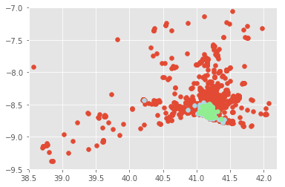
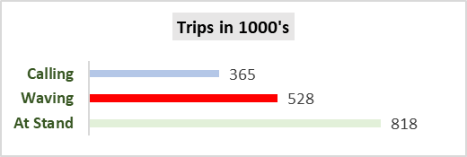
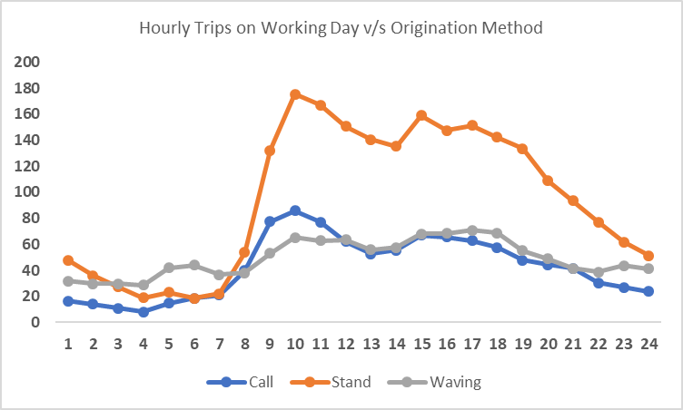
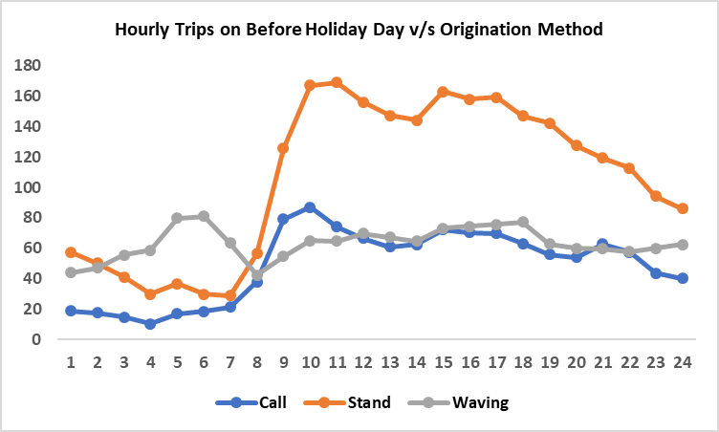
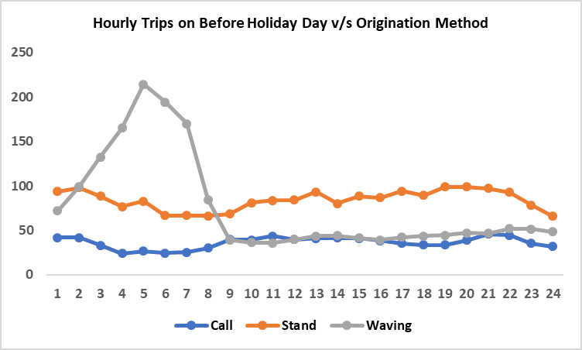
Data Analysis
Both B2B and B2C Models:
3 Customer IDs, doing more than 10 trips in a day
Customer 2002, doing ~160 trips in a day
Inference: These are working as Aggregators
Interesting Pattern for further Analysis

Slide 5
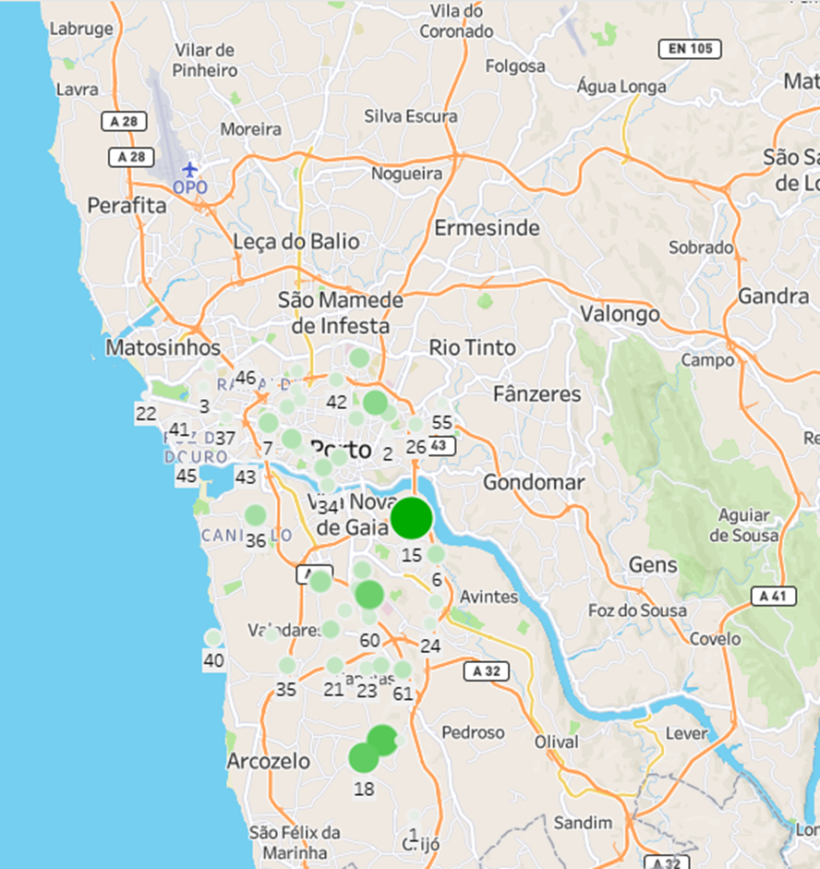
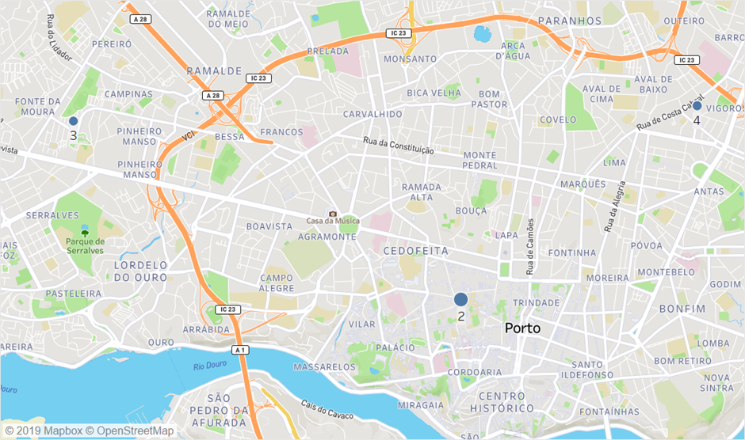
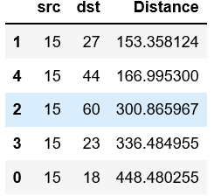
Working Day – Taxi Stand Analytics during Peak hours
K- means Clustering on Trip end Lat and Longs
Cluster centres with maximum number of trips ending.
Thought!! Office going customers, return trip from these clusters? Taxi locations!!
Stands Generating max rides – Stand 15 is Busiest
Create Edges Table with Stand ID and Lat Long
Create Vertices Table having Source as stand ID and dest as other stand IDs and Distance between them – all combinations
Create Graph Frame
Taxi Demand fulfilment at Taxi stands

Slide 6
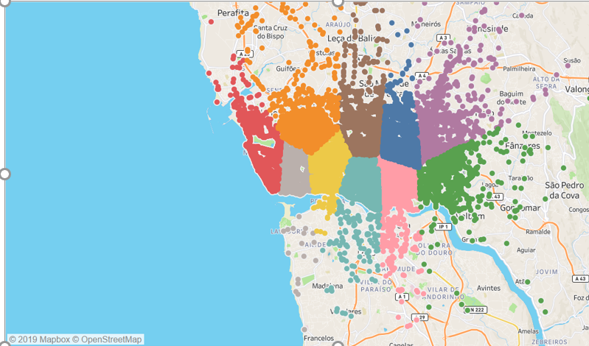


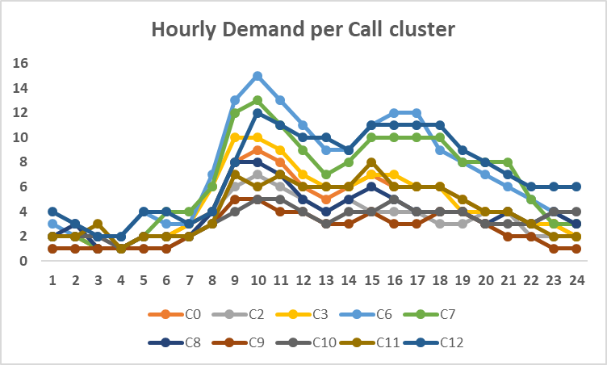
Customer Segment – Taxi Hire by Call – Analytics
Clique Formation
Cluster 4 <-> Cluster 12
Cluster 4 <-> Cluster 2
2
4
Need Taxi, asap plz!!
Sure!!
12
First find the cluster of customer… Ah ha its 4!!
But which taxi will be nearest??
Lets find the distance of customer coordinate from cluster 4 and all its cliques
Bingo!!! 4-12 clique is shortest, lets connect to Taxis in shaded area in map!!

Slide 7
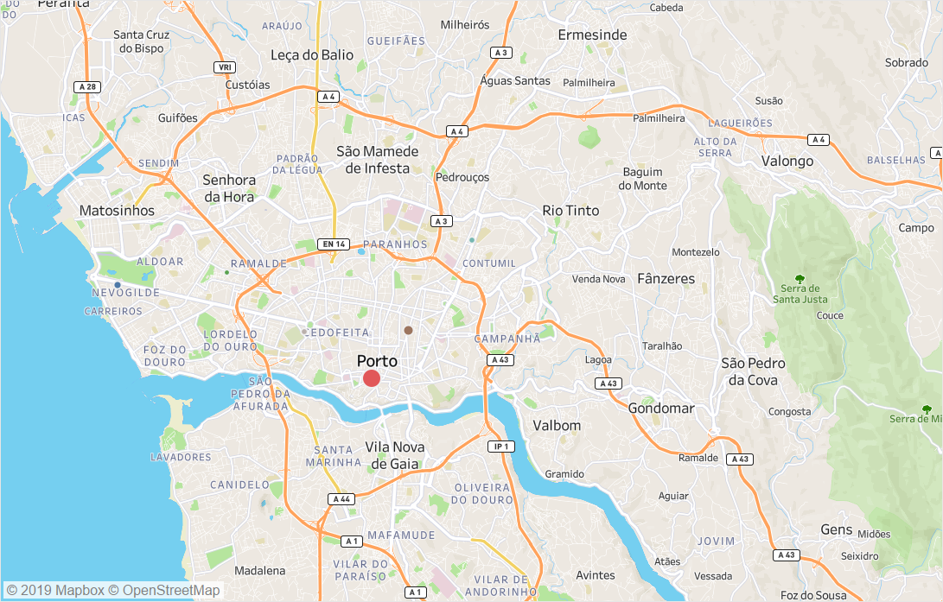
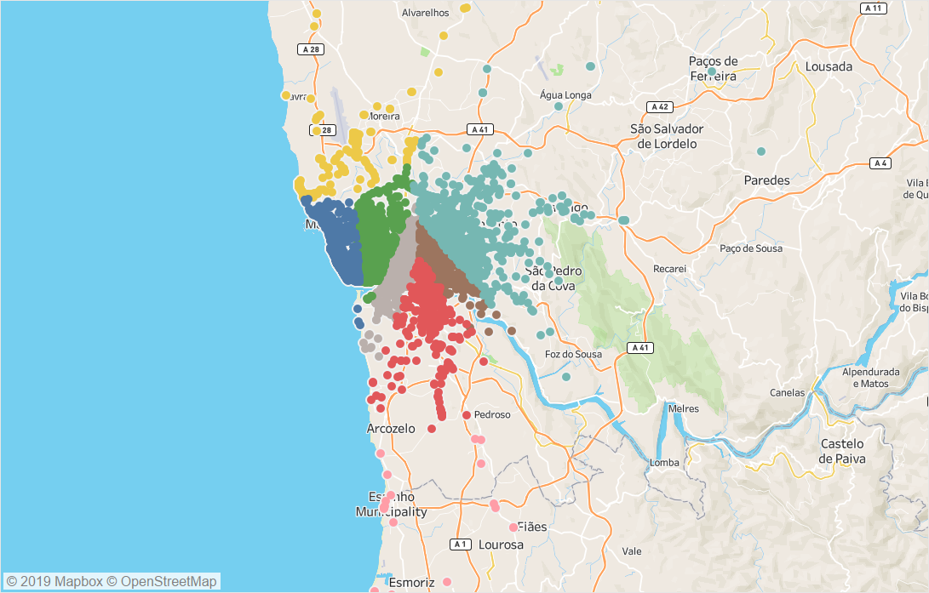
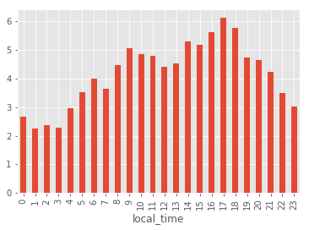
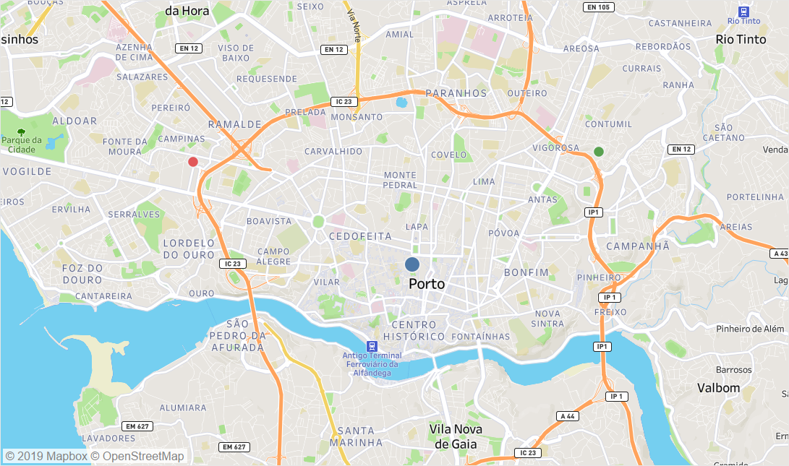
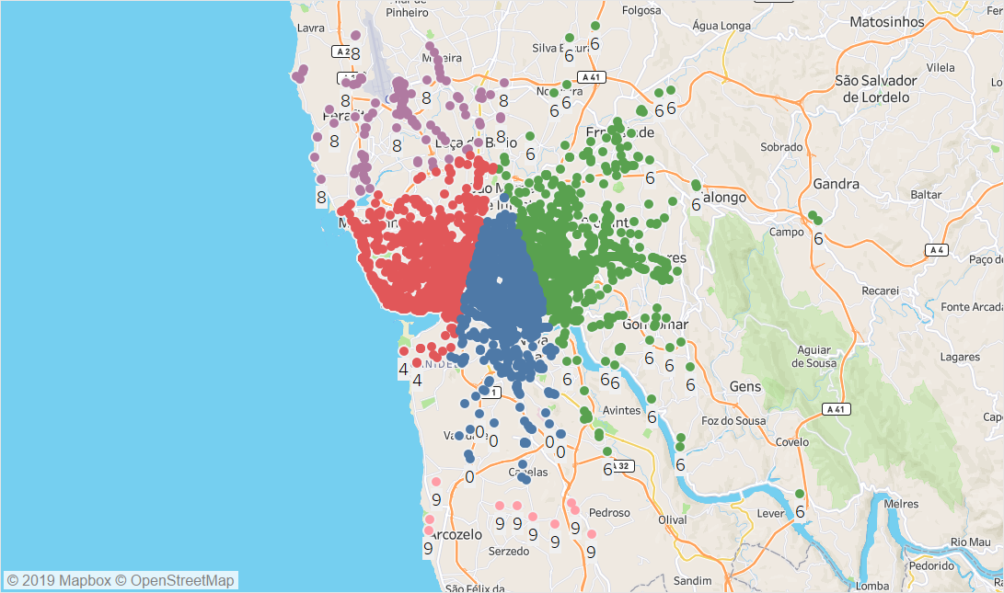
Waving Customer Segment – Holidays Midnight/Early Morning
Max Rides generating from this cluster centre ~ 360 rides between 4 to 6 AM
Breakdown/ No Ride Analysis
Areas with max trip cancellation/breakdown

Slide 8
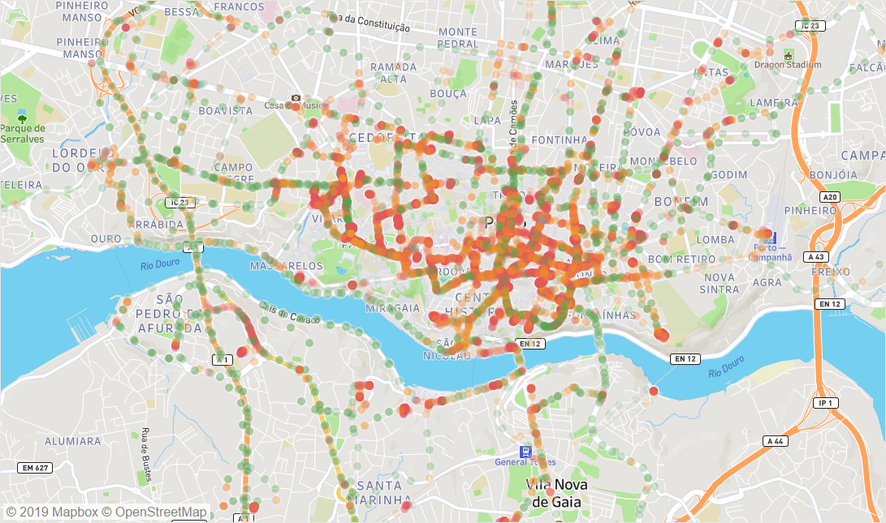
Route Congestion Analysis – During 10-11 AM Work Days
All rides from 10-11 AM on working Day
For each ride, calculate distance between 15 seconds position
Distance <40m then Red, between 40-125m Amber else Green
Filter routes having mote than 50% Red coordinates
Cluster the Red coordinates and find the cluster with max Congestion points
Top 100 Routes falling passing with these major clusters
Develop Hourly model on the above congested routes, identify pattern
This can be fed in to dynamic pricing model
Also continuous congested points/routes can be further analysed to identify strategic solution of de-congestion.

Slide 9
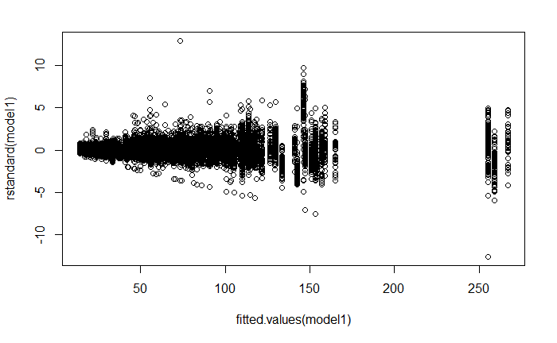
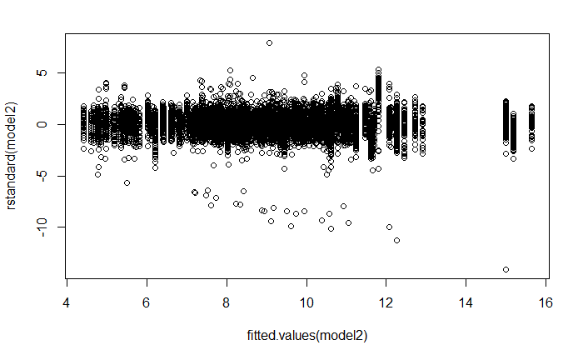
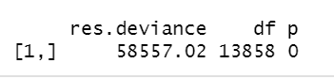
Prediction – Model for Predicting Trips for a Stand ID for particular day
Taxi stand ID - Factor
Day Type – A, B or C
Y = Total Trip from Stand
Models
Train
Linear regression
LM with Box Cox
LM with Logarithmic
GLM Poisson Count
Val
LM with Box Cox
LM with Logarithmic
Test
LM with Logarithmic
Heteroscedasticity from Linear regression
Heteroscedasticity removed with Box-cox and Log xformation
P value 0 in Poisson model for Train, rejecting the model
Validation
Test
LM with Box Cox
: 0.79 Adjusted R2
LM with Logarithmic
: 0.79 Adjusted R2
LM with Logarithmic
: 0.81 Adjusted R2

Slide 10

Predict Destination and trip Duration given start Point
Start Lat-Long Point of all Trips
End Lat - Long Point of all Trips
K-means Cluster
K-means Cluster
Customer Boarding Taxi
Geo Codes
Extract:
End cluster Number having highest probability, given start cluster number
Cluster Mean as destination
Average Time duration
Cluster number

Slide 11
Predict next point in path, given previous points
Model Used
Gaussian Mixture Model (GMM) + Hidden Markov Model (HMM)
Step 1 - Initialization
State 3
Clus 2
State 1
State 2
State 4
Clus 6
Clus 6
Clus 5
Observed Points
??
[41.145948,-8.612595] [41.145876,-8.612334] [41.145903,-8.611731]
41.145976, -8.60913
All rides from 10-11 AM on working Day
For each ride, extract each lat/lon points
Deploy GMM on each set of lat/lon point
Identify Prior Probabilities of each cluster in each set
Compute Transition Probabilities from each set to next set i.e. after 15 seconds, which cluster trip is moving!!
Identify Probabilities of these points coming from each cluster under each set – Emission Probabilities
Using Viterbi Algorithm, identify the value of State 1, 2 and 3 in terms of Cluster Number
For past entries, identify the best cluster for state 4 which follows state 1, 2 and 3
For identified cluster of state 4, find the lat/lon for which distance between that point and state3 point is equal to
Distance between state 3 and state 2 observed points

Slide 12
Conclusion and Additional Thoughts
Cab service business thrives on value customer services i.e. minimum customer wait time, quick to reach destination.
This helps in enhanced customer experience as well as low fuel consumption, more trips resulting in enhanced revenue
Using basic analysis. we tried to reveal the insights like:
Where to position cabs during working days
How to fulfil demand at stands
Position cabs during holiday nights
Position cabs so that person calling will get the taxi in minimum time
Predictions
2 areas we can further more focus on:
Customer profiling i.e. what is customer hiring pattern etc so that personalized offers can be created including sharing proposition
Taxi driver profiling i.e. how many trips per day, lag between 2 trips etc. This can help in creating well defined Driver Incentive Model
Utilize the route congestion model, demand etc, we can create Dynamic Pricing model as well.
Thanks

